Slide 1

ReactJS
Dr. Adeel Ansari

Slide 2
Prerequisites
There are a few things you should know in advance before you start playing around with React. If you've never used JavaScript or the DOM at all before, for example, I would get more familiar with those before trying to tackle React.
Here are what I consider to be React prerequisites.
Basic familiarity with HTML & CSS.
Basic knowledge of JavaScript and programming.
Basic understanding of the DOM.
Familiarity with ES6 syntax and features.
Node.js and npm installed globally.

Slide 3
The Document Object Model
The Document Object Model, usually referred to as the DOM, is an essential part of making websites interactive. It is an interface that allows a programming language to manipulate the content, structure, and style of a website. JavaScript is the client-side scripting language that connects to the DOM in an internet browser.
Almost any time a website performs an action, such as rotating between a slideshow of images, displaying an error when a user attempts to submit an incomplete form, or toggling a navigation menu, it is the result of JavaScript accessing and manipulating the DOM. In this article, we will learn what the DOM is, how to work with the document object, and the difference between HTML source code and the DOM.
https://www.taniarascia.com/introduction-to-the-dom/

Slide 4
What is the Difference Between the DOM and HTML Source Code?
There are two instances in which the browser-generated DOM will be different than HTML source code:
The DOM is modified by client-side JavaScript
The browser automatically fixes errors in the source code
https://www.taniarascia.com/introduction-to-the-dom/

Slide 5
What is React?
React is a JavaScript library - one of the most popular ones, with over 100,000 stars on GitHub.
React is not a framework (unlike Angular, which is more opinionated).
React is an open-source project created by Facebook.
React is used to build user interfaces (UI) on the front end.
React is the view layer of an MVC application (Model View Controller)
One of the most important aspects of React is the fact that you can create components, which are like custom, reusable HTML elements, to quickly and efficiently build user interfaces.
React also streamlines how data is stored and handled, using state and props.

Slide 6
What is React?
React has a few different kinds of components, but we’ll start with React.Component subclasses:
React is a declarative, efficient, and flexible JavaScript library for building user interfaces.
It lets you compose complex UIs from small and isolated pieces of code called “components”.
We use components to tell React what we want to see on the screen. When our data changes, React will efficiently update and re-render our components.
Here, ShoppingList is a React component class, or React component type. A component takes in parameters, called props (short for “properties”), and returns a hierarchy of views to display via the render method.
class ShoppingList extends React.Component {
render() {
return (
<div className="shopping-list">
<h1>Shopping List for {this.props.name}</h1>
<ul>
<li>Instagram</li>
<li>WhatsApp</li>
<li>Oculus</li>
</ul>
</div>
);
}
} // Example usage: <ShoppingList name="Mark" />

Slide 7
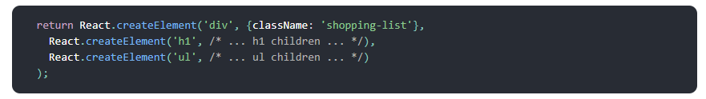
What is React?
The render method returns a description of what you want to see on the screen.
React takes the description and displays the result.
In particular, render returns a React element, which is a lightweight description of what to render.
Most React developers use a special syntax called “JSX” which makes these structures easier to write.
The <div /> syntax is transformed at build time to React.createElement('div’). The example above is equivalent to:

Slide 8
What is React?
JSX comes with the full power of JavaScript. You can put any JavaScript expressions within braces inside JSX.
Each React element is a JavaScript object that you can store in a variable or pass around in your program.
The ShoppingList component above only renders built-in DOM components like <div /> and <li />. But you can compose and render custom React components too. For example, we can now refer to the whole shopping list by writing <ShoppingList />. Each React component is encapsulated and can operate independently; this allows you to build complex UIs from simple components.

Slide 9
What is React?
At the heart of all React applications are components.
A component is a self-contained module that renders some output.
We can write interface elements like a button or an input field as a React component.
Components are composable.
A component might include one or more other components in its output.

Slide 10
React Pipeline
While React can be used without a build pipeline, we recommend setting it up so you can be more productive. A modern build pipeline typically consists of :
A package manager, such as yarn or npm. It lets you take advantage of a vast ecosystem of third-party packages, and easily install or update them.
A bundler, such as webpack or Browserify. It lets you write modular code and bundle it together into small packages to optimize load time.
A compiler such as Babel. It lets you write modern JavaScript code that still works in older browsers.

Slide 11
ES5/ES6 ?
In any cursory search on the Internet looking for React material, no doubt you have already run into the terms JSX, ES5, and ES6.
These opaque acronyms can get confusing quickly. ES5 (the ES stands for ECMAScript) is basically "regular JavaScript".
The 5th update to JavaScript, ES5 was finalized in 2009. It has been supported by all major browsers for several years. Therefore, if you've written or seen any JavaScript in the recent past, chances are it was ES5.
ES6 is a new version of JavaScript that adds some nice syntactical and functional additions. It was finalized in 2015. ES6 is almost fully supported by all major browsers. But it will be some time until older versions of web browsers are phased out of use.
For instance, Internet Explorer 11 does not support ES6, but has about 12% of the browser market share.

Slide 12
JSX
As we'll see, all of our React components have a render function that specifies what the HTML output of our React component will be. JavaScript eXtension, or more commonly JSX, is a React extension that allows us to write JavaScript that looks like HTML.
class HelloWorld extends React.Component {
render() {
return (
<h1 classname="large">Hello World</h1>
);
}
}

Slide 13
JSX (Cont...)
The render() function in the HelloWorld component looks like it's returning HTML, but this is actually JSX. The JSX is translated to regular JavaScript at runtime. That component, after translation, looks like this:
class HelloWorld extends React.Component {
render() {
return (
React.createElement(
'h1',
{className: 'large'},
'Hello World'
)
);
}
}

Slide 14
How does React Work?
React creates a VIRTUAL DOM in memory.
Instead of manipulating the browser's DOM directly, React creates a virtual DOM in memory, where it does all the necessary manipulating, before making the changes in the browser DOM.
React only changes what needs to be changed!
React finds out what changes have been made, and changes only what needs to be changed.

Slide 15
Declarative Paradigm
React is declarative because we write the code that we want and React is in charge of taking our declared code and performing all of the JavaScript/DOM steps to get us to our desired result.
While Imperative code instructs JavaScript on how it should perform each step. With declarative code, we tell JavaScript what we want to be done, and let JavaScript take care of performing the steps

Slide 16
Setup and Installation
There are a few ways to set up React, and I'll show you two so you get a good idea of how it works.
Static HTML File
This first method is not a popular way to set up React and is not how we'll be doing the rest of our tutorial, but it will be familiar and easy to understand if you've ever used a library like jQuery, and it's the least scary way to get started if you're not familiar with Webpack, Babel, and Node.js.
Let's start by making a basic index.html file. We're going to load in three CDNs in the head - React, React DOM, and Babel. We're also going to make a div with an id called root, and finally we'll create a script tag where your custom code will live

Slide 17
<!DOCTYPE html>
<html>
<head>
<meta charset="utf-8" />
<title>Hello React!</title>
<script src="https://unpkg.com/react@^16/umd/react.production.min.js"></script>
<script src="https://unpkg.com/react-dom@16.13.0/umd/react-dom.production.min.js"></script>
<script src="https://unpkg.com/babel-standalone@6.26.0/babel.js"></script>
</head>
<body>
<div id="root"></div>
<script type="text/babel">
// React code will go here
</script>
</body>
</html>

Slide 18
Static HTML File
React - the React top level API
React DOM - adds DOM-specific methods
Babel - a JavaScript compiler that lets us use ES6+ in old browsers
The entry point for our app will be the root div element, which is named by convention. You'll also notice the text/babel script type, which is mandatory for using Babel.
Now, let's write our first code block of React. We're going to use ES6 classes to create a React component called App.

Slide 19
Static HTML File
class App extends React.Component {
//...
}
Now we'll add the render() method, the only required method in a class component, which is used to render DOM nodes.
class App extends React.Component {
render() {
return (
//...
);
}
}

Slide 20
Static HTML File
Inside the return, we're going to put what looks like a simple HTML element. Note that we're not returning a string here, so don't use quotes around the element. This is called JSX, and we'll learn more about it soon.
class App extends React.Component {
render() {
return <h1>Hello world!</h1>
}
}
Finally, we're going to use the React DOM render() method to render the App class we created into the root div in our HTML.
ReactDOM.render(<App />, document.getElementById('root'))

Slide 21
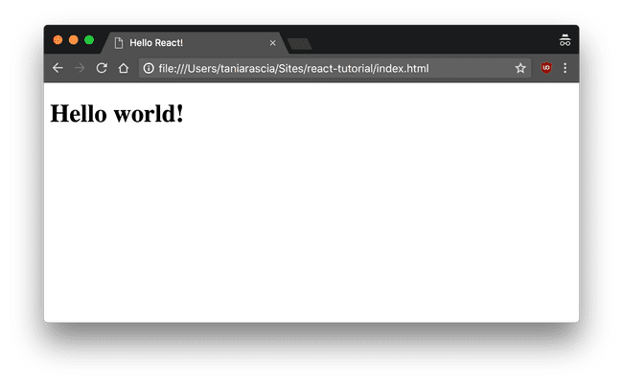
<!DOCTYPE html>
<html>
<head>
<meta charset="utf-8" />
<title>Hello React!</title>
<script src="https://unpkg.com/react@16/umd/react.development.js"></script>
<script src="https://unpkg.com/react-dom@16/umd/react-dom.development.js"></script>
<script src="https://unpkg.com/babel-standalone@6.26.0/babel.js"></script>
</head>
<body>
<div id="root"></div>
<script type="text/babel">
class App extends React.Component {
render() {
return <h1>Hello world!</h1>
}
}
ReactDOM.render(<App />, document.getElementById('root'))
</script>
</body>
</html>
Now if you view your index.html in the browser, you'll see the h1 tag we created rendered to the DOM.

Slide 22
Create React App
The method we just used of loading JavaScript libraries into a static HTML page and rendering the React and Babel on the fly is not very efficient, and is hard to maintain.
Fortunately, Facebook has created Create React App, an environment that comes pre-configured with everything you need to build a React app.
It will create a live development server, use Webpack to automatically compile React, JSX, and ES6, auto-prefix CSS files, and use ESLint to test and warn about mistakes in the code.

Slide 23
Setting up a React Environment & Getting Started
If you have NPM and Node.js installed, you can create a React application by first installing the create-react-app.
Install create-react-app by running this command in your terminal:
Then you are able to create a React application, let's create one called myfirstApp.
Run this command to create a React application named myfirstApp:
C:\Users\Your Name>npm install -g create-react-app
npx create-react-app myfirstApp
A new browser window will pop up with your newly created React App! If not, open your browser and type localhost:3000 in the address bar.
Run this command to run the React application myfirstApp:
npm start

Slide 24
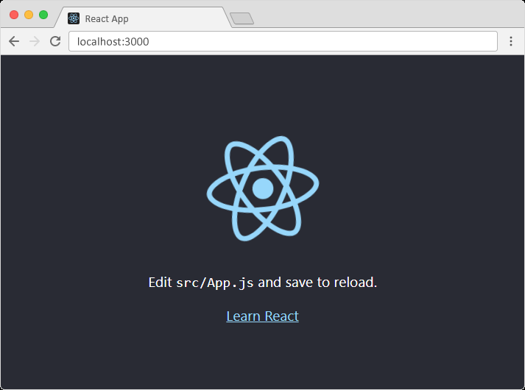

Slide 25
Project Structure
If you look into the project structure, you'll see a /public and /src directory, along with the regular node_modules, .gitignore, README.md, and package.json.
In /public, our important file is index.html, which is very similar to the static index.html file we made earlier - just a root div. This time, no libraries or scripts are being loaded in.
The /src directory will contain all our React code.
Go ahead and delete all the files out of the /src directory, and we'll create our own boilerplate file without any bloat. We'll just keep index.css and index.js.

Slide 26
Now in index.js, we're importing React, ReactDOM, and the CSS file.
src/index.js
import React from 'react'
import ReactDOM from 'react-dom'
import './index.css'
Let's create our App component again. Before, we just had an <h1>, but now I'm adding in a div element with a class as well. You'll notice that we use className instead of class. This is our first hint that the code being written here is JavaScript, and not actually HTML.
src/index.js
class App extends React.Component {
render() {
return (
<div className="App">
<h1>Hello, React!</h1>
</div>
)
}
}

Slide 27
Finally, we'll render the App to the root as before.
ReactDOM.render(<App />, document.getElementById('root'))
Here's our full index.js. This time, we're loading the Component as a property of React, so we no longer need to extend React.Component.
import React, {Component} from 'react'
import ReactDOM from 'react-dom'
import './index.css'
class App extends Component {
render() {
return (
<div className="App">
<h1>Hello, React!</h1>
</div>
)
}
}
ReactDOM.render(<App />, document.getElementById('root'))
If you go back to localhost:3000, you'll see "Hello, React!" just like before. We have the beginnings of a React app now.

Slide 28
End of Introduction

